Slide 1
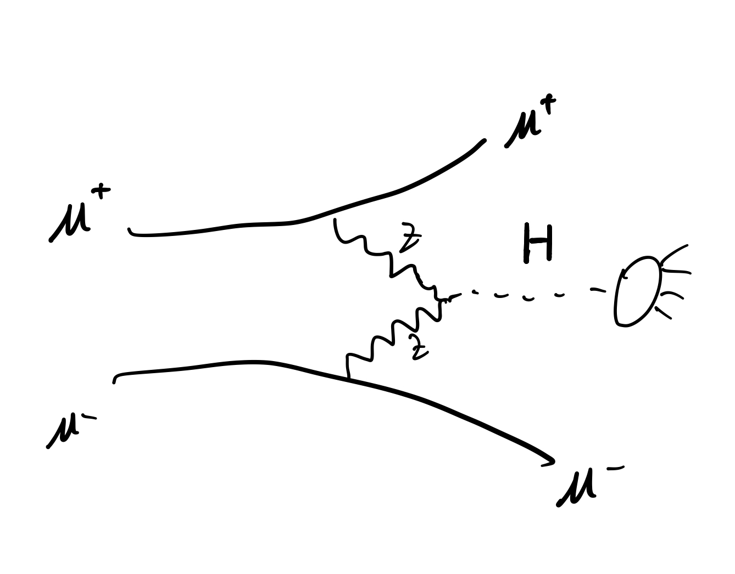

HZZ precision measurement
6/27/2023
Forward detector
Two ForwardMuons are visible.
$$2.5<η\left(μ\right)<4 or 6 or 8$$
$$m_{H}^{2}={\left[\left(10000, 0, 0, 0\right)−μ^{+}−μ^{−}\right]}^{2}$$

Slide 2
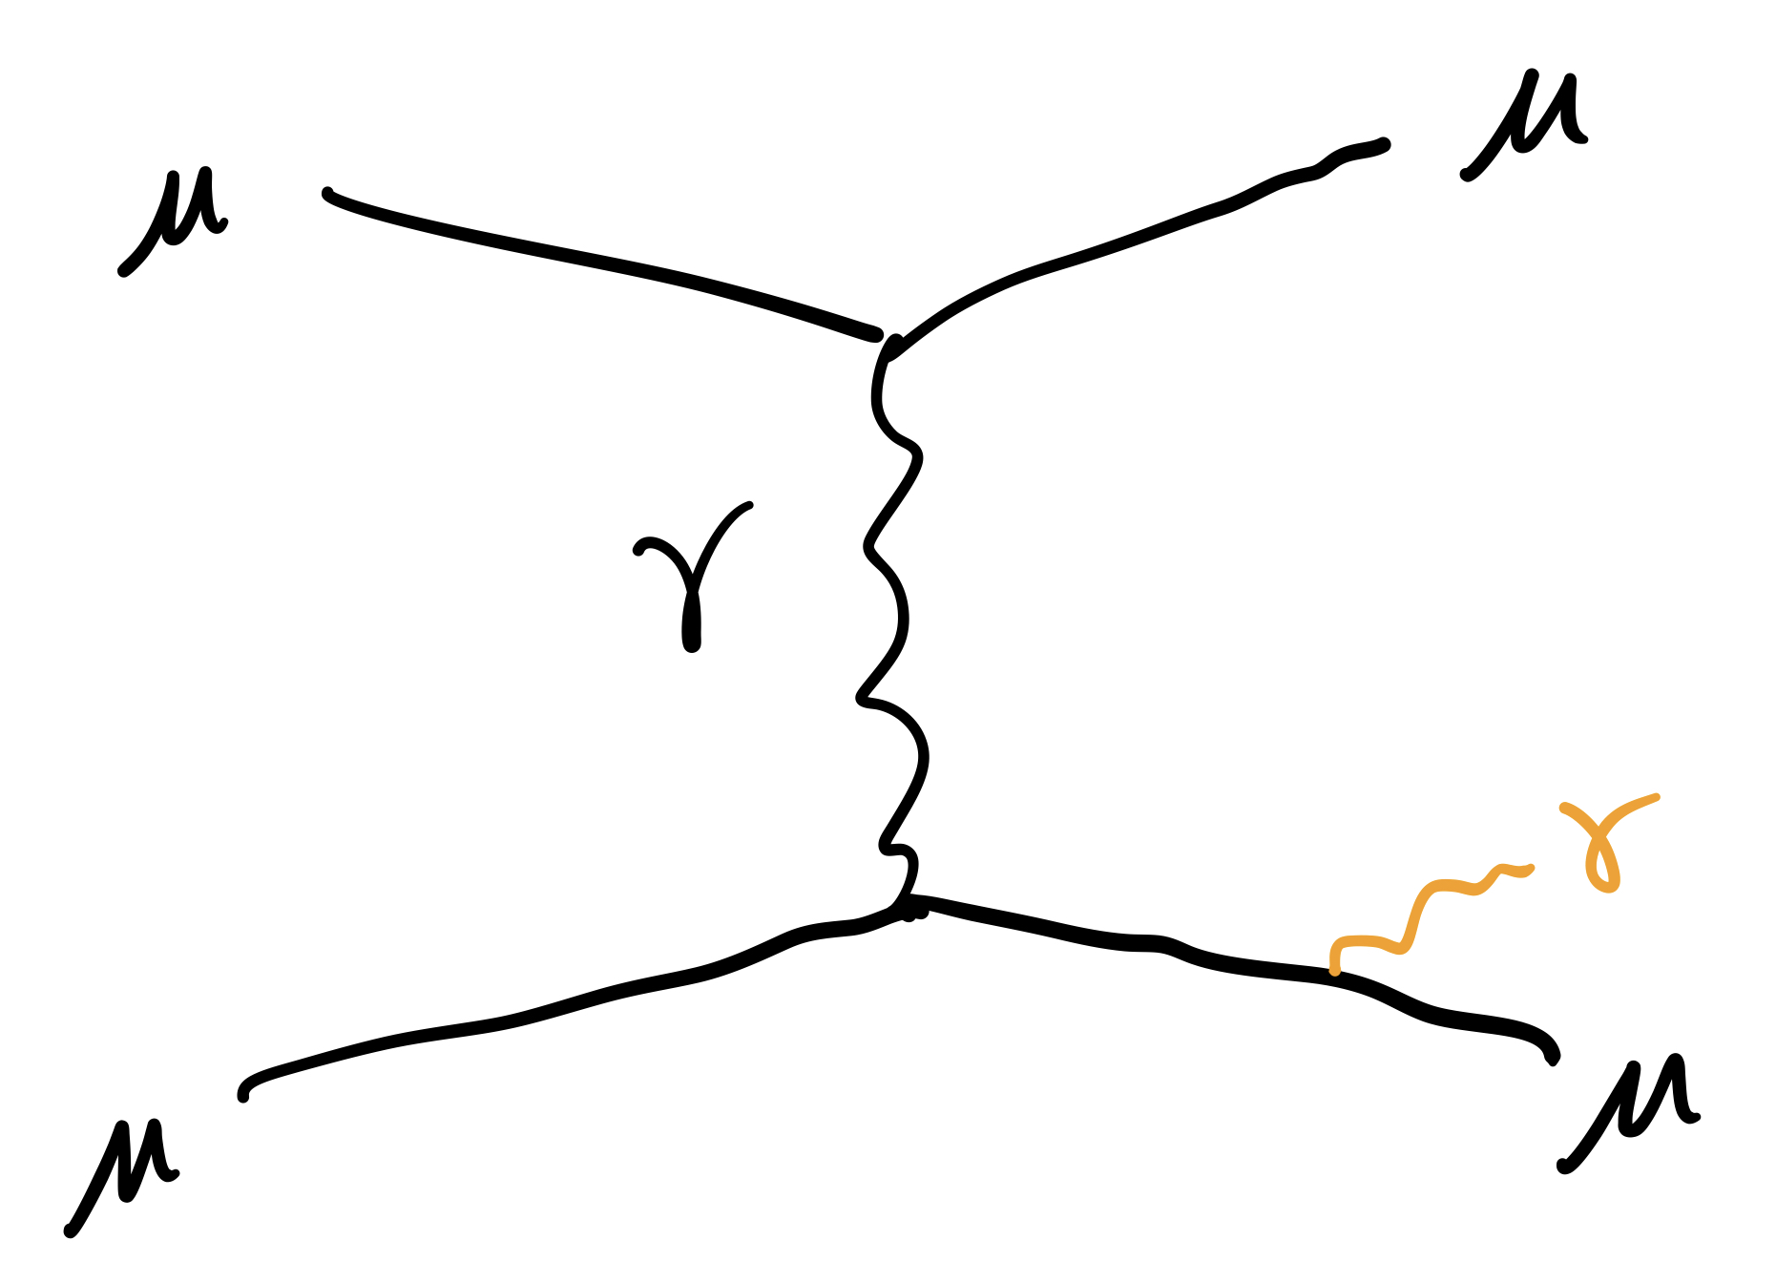
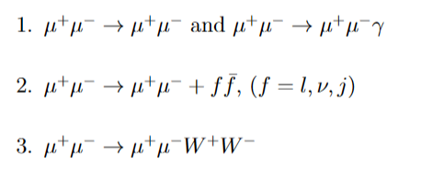
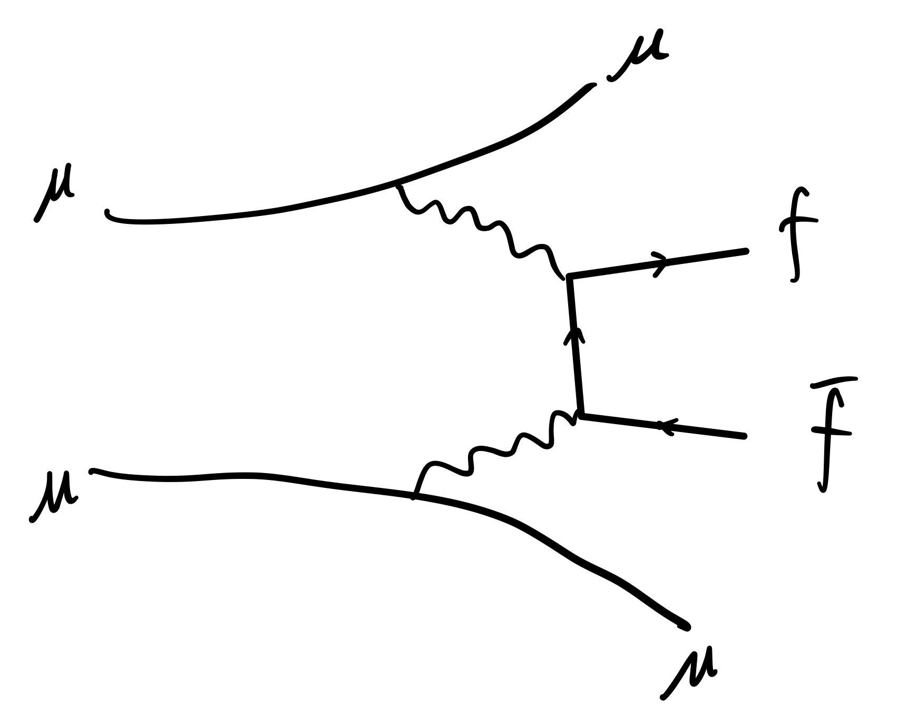
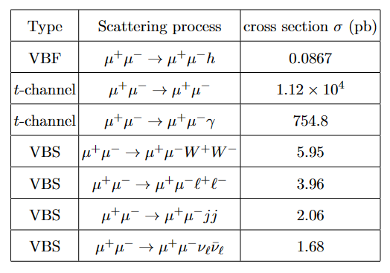
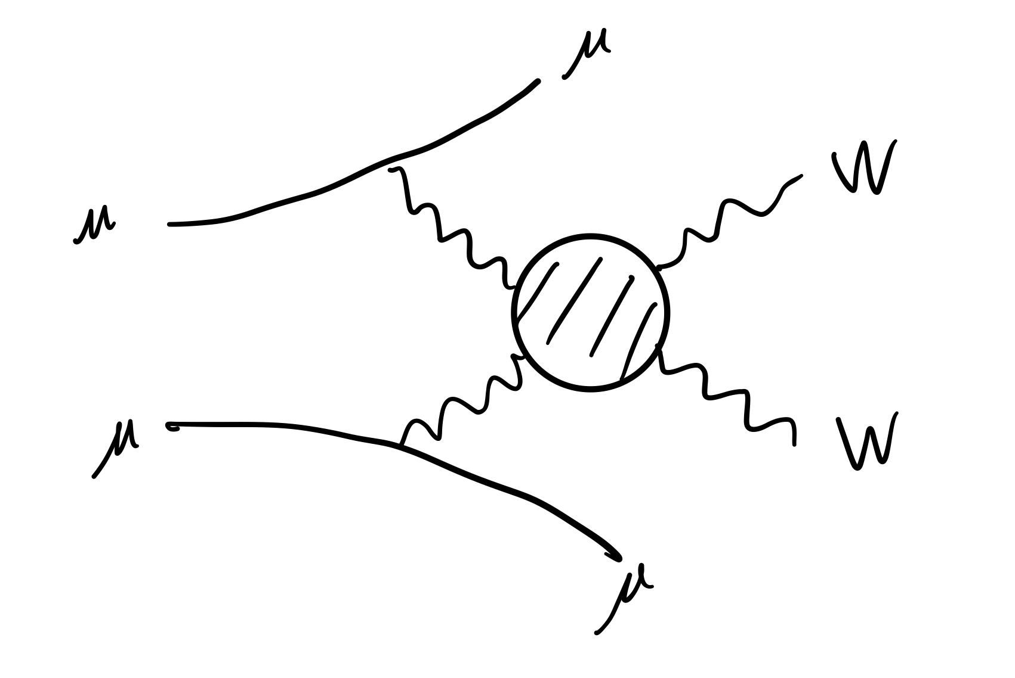
Bkg
Signal

Slide 3
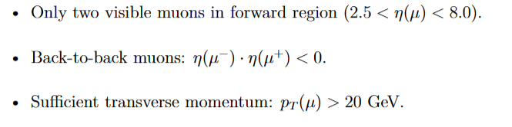
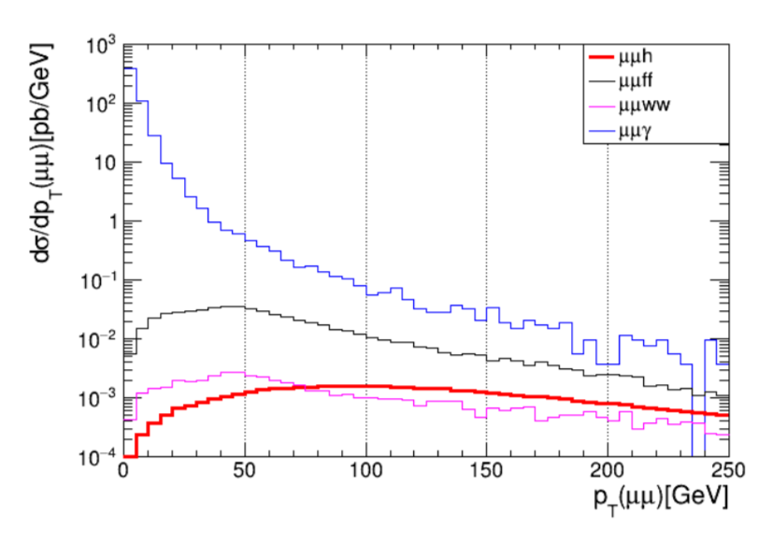
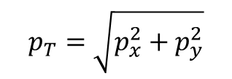

After pre-selection:
$$p_{T}\left(μμ\right)>50 GeV$$
$$p_{T}=\sqrt{p_{x}^{2}+p_{y}^{2}}$$

Slide 4
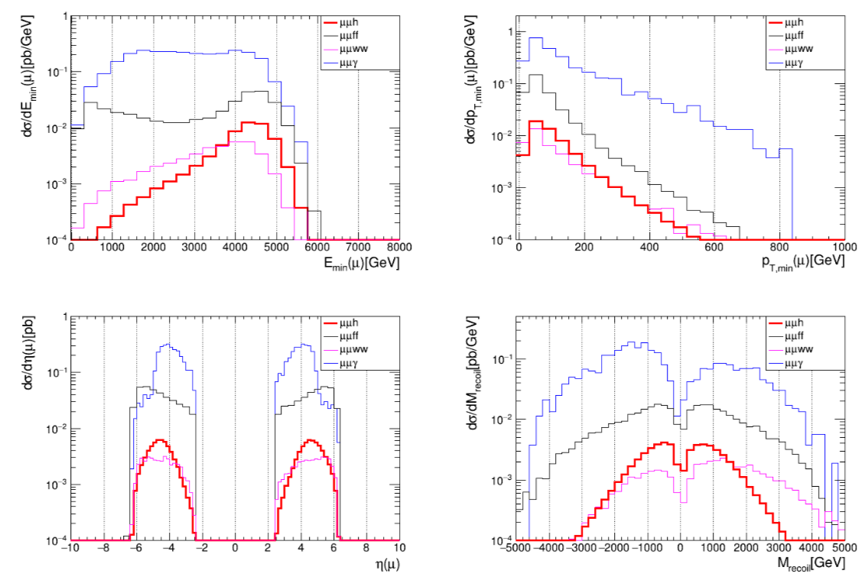

After $p_{T}\left(μμ\right)>50 GeV$
Not 125 GeV
Because the resolution for high energy forward muon is too bad

Slide 5
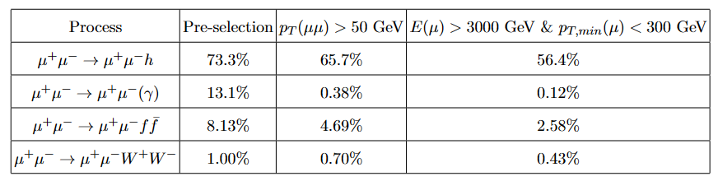
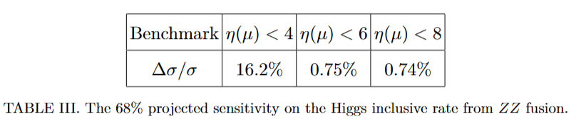
Cutflow table

Slide 6
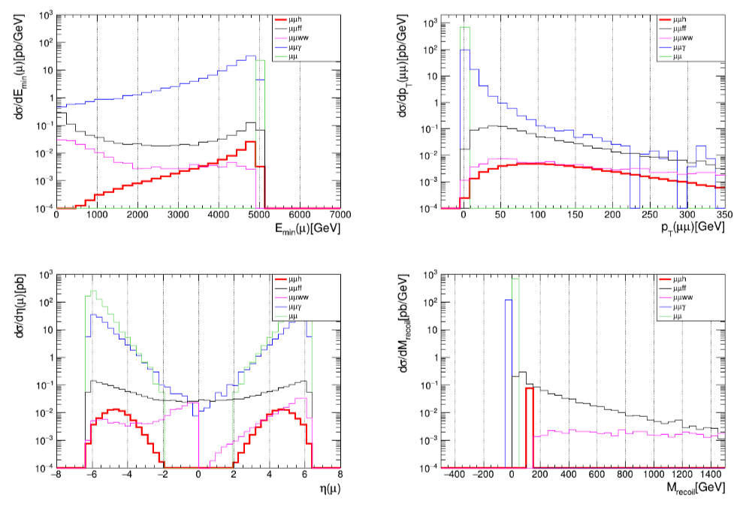
Parton level

Slide 7
HZZ precision measurement
7/13/2023
Two ForwardMuons are visible. $2.5<η\left(μ\right)<4 or 6 or 8$

Slide 8
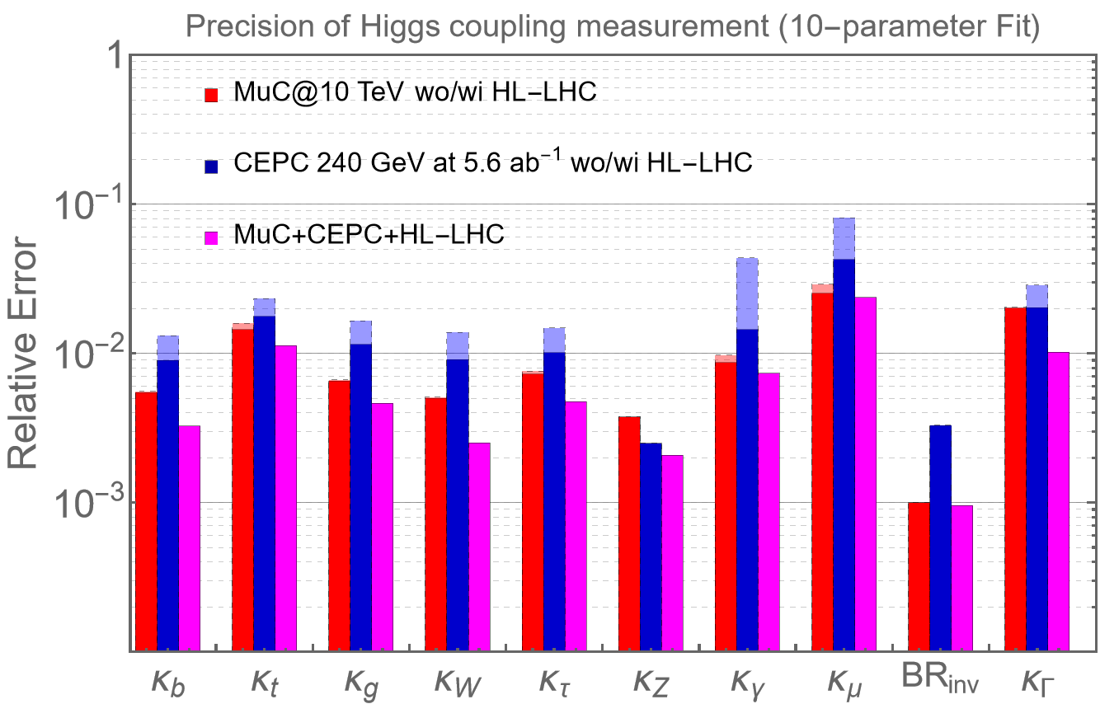

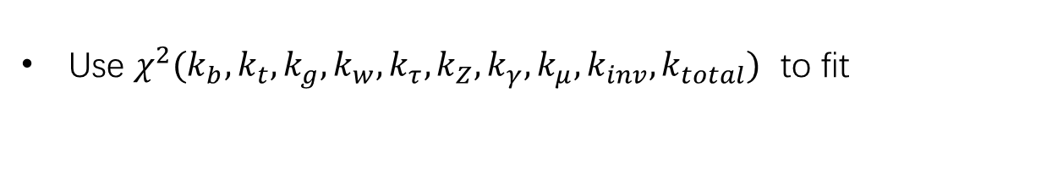
Higgs 10-parameters fit
MuC:
Matthew Forslund and Patrick Meade. Arxiv:2203.09425
M. Ruhdorfer, E. Salvioni, A. Wulzer. Arxiv:2303.14202 (invisible Br)
2308.06323.pdf (arxiv.org). (VV>H*>tt)
2008.12204.pdf (arxiv.org) (WW:ZZ=10:1)
Our result. (HZZ)
Use $χ^{2}(k_{b},k_{t},k_{g},k_{w},k_{τ},k_{Z},k_{γ},k_{μ},k_{inv},k_{total})$ to fit
HL-LHC:
GuidelinesCouplingProjections2018 < LHCPhysics < TWiki (cern.ch)
Invisible decays of the Higgs boson at the HL-LHC: experimental overview - On behalf of ATLAS and CMS H invisible teams (cern.ch)
Relative error=$\frac{1}{2}(bound_{upper}−bound_{lower})$

Slide 10
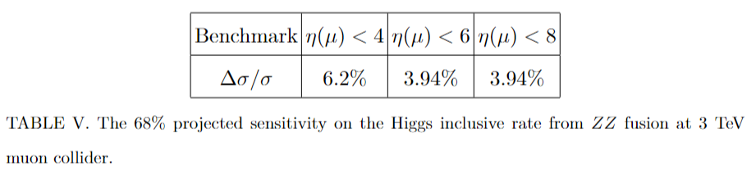
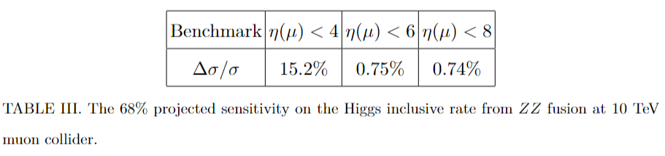
3/10 TeV muon collider

Slide 11
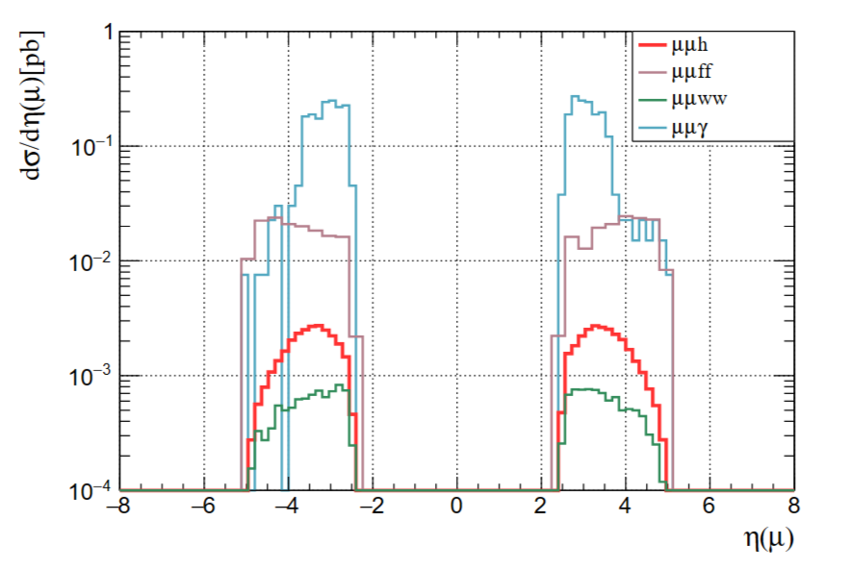
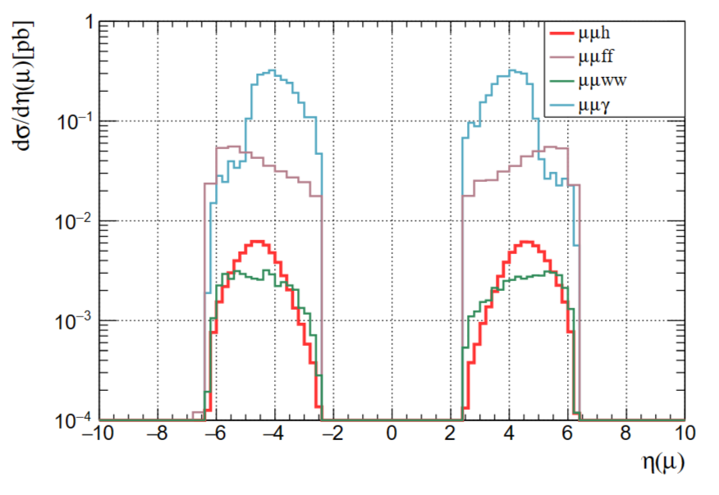
3/10 TeV muon collider
3 TeV
10 TeV

Slide 12
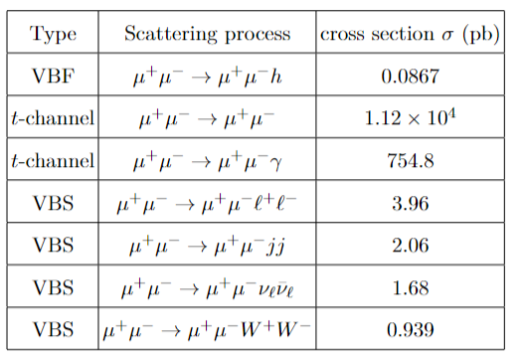
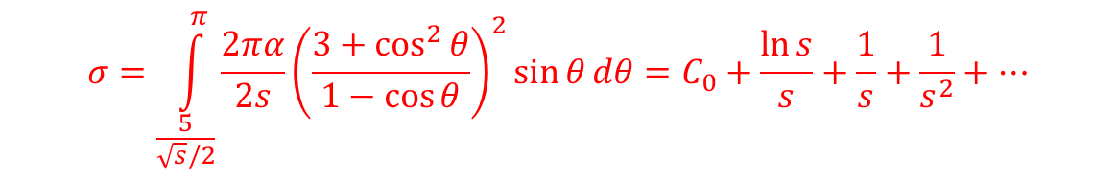
3/10 TeV muon collider
Xs (pb) @3 TeV
0.05
1.12*10^4
753
2.7
1.5
1.04
0.3386
same
$$σ=\int_{\frac{5}{\sqrt{s}/2}}^{π}{\frac{2πα}{2s}{\left(\frac{3+\cos^{2}{θ}}{1−\cos{θ}}\right)}^{2}\sin{θ}dθ=C_{0}+\frac{\ln{s}}{s}+\frac{1}{s}+\frac{1}{s^{2}}+…}$$

Slide 13
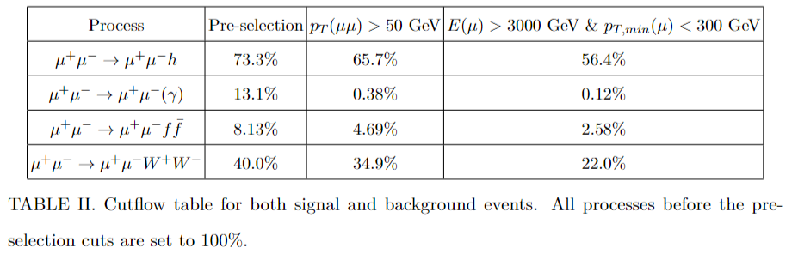
3 TeV | Pre-selection | pT(mumu)>50 | E(mu)>300
signal | 62% | 53% | 48%
mumu gamma | 12.7% | 0.22% | 0.11%
ff | 6.4% | 1.45% | 0.93%
WW | 23.6% | 18.3% | 13.7%

Slide 14
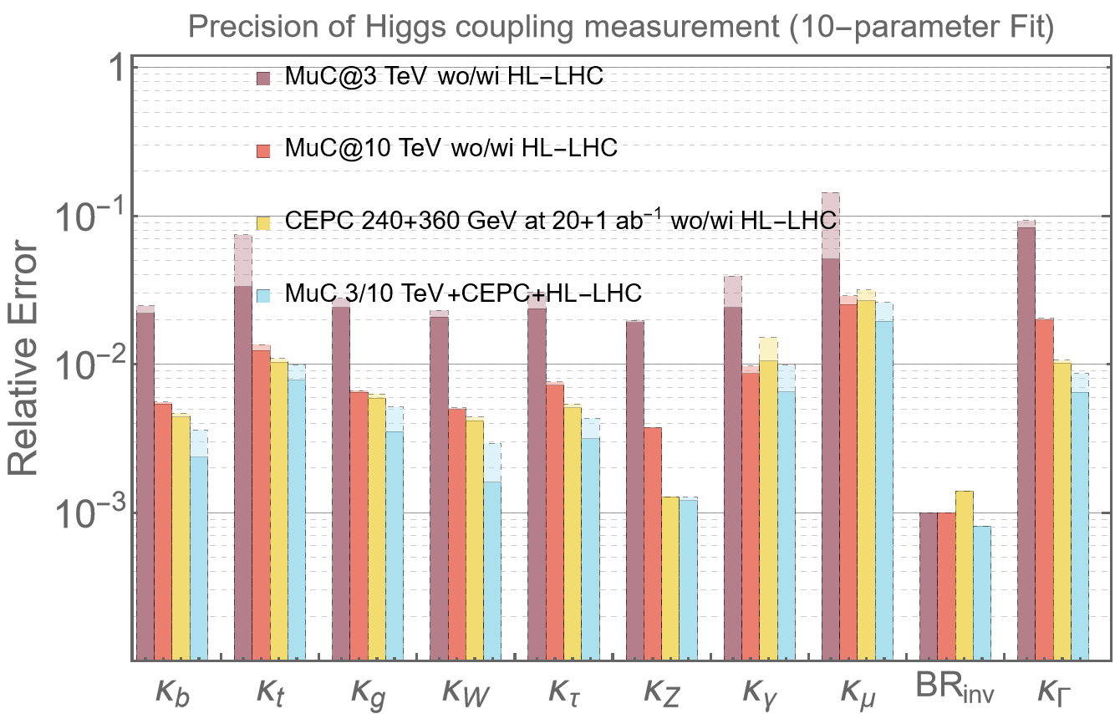
Latest vs. Previous result

Slide 15
10p global fit

Slide 16
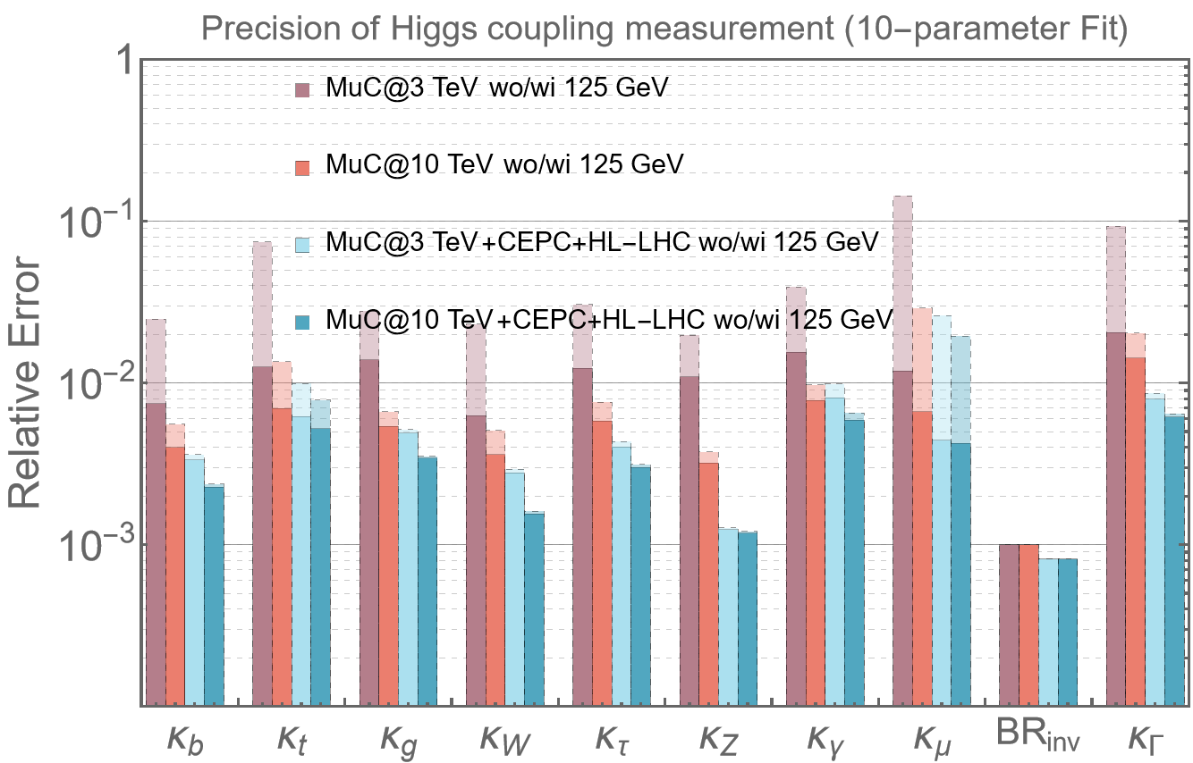
Combine with MuC 125GeV

Slide 17


Convert $k_{Γ}$ to $BR_{BSM}$
$$BR_{BSM}$$

Slide 18
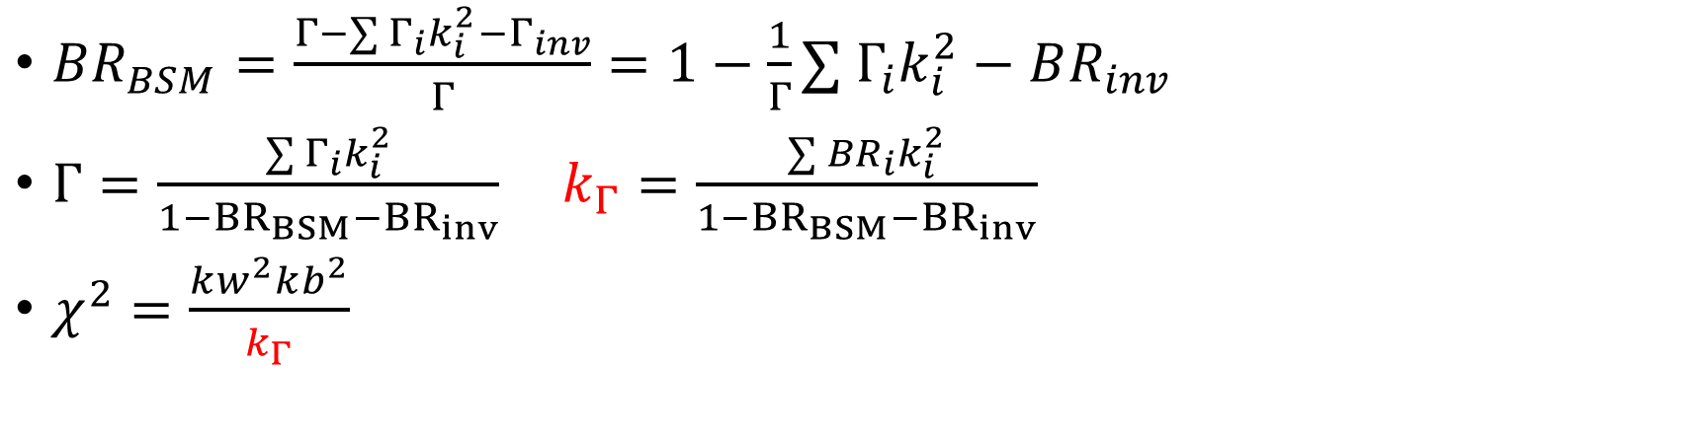

Convert $k_{Γ}$ to $BR_{BSM}$
$BR_{BSM}=\frac{Γ−∑{ Γ}_{i}k_{i}^{2}−Γ_{inv}}{Γ}=1−\frac{1}{Γ}∑{ Γ}_{i}k_{i}^{2}−BR_{inv}$
$Γ=$ $\frac{∑{ Γ}_{i}k_{i}^{2}}{1−{BR}_{BSM}−{BR}_{inv}}$ $k_{Γ}=\frac{∑{ BR}_{i}k_{i}^{2}}{1−{BR}_{BSM}−{BR}_{inv}}$
$χ^{2}=\frac{kw^{2}kb^{2}}{k_{Γ}}$

Slide 19

To Do
Fix the converting between $k_{Γ}$ and ${BR}_{BSM}$
Complete the draft

